Slide 1
Design and Development of a Budget-Friendly Autonomous Drone for Short-Range Package Delivery
CSE7101- Capstone Project
Review-5
Batch Number: ISE_44
Roll Number | Student Name
20221ISE0001 | GORTHI DEVENDRA NAIDU
20221ISE0005 | BODIMANI SAI DORABABU REDDY
20221ISE0081 | MANOJ HK
Under the Supervision of,
Dr./Mr./Ms./Prof.: VIDYA R
Professor / Associate Professor / Assistant Professor
School of Computer Science and Engineering
Presidency University
Name of the Program: B.Tech (ISE)
Name of the HoD: Zaffar Ali Khan
Name of the Program Project Coordinator: Suma N
Name of the School Project Coordinators: Dr. Sampath

Slide 2
Problem Statement Number: PSCS 135
Organization: PRESIDENCY UNIVERSITY
Category (Hardware / Software / Both) : HARDWARE
Problem Description: Student Innovation

Slide 3
Content
Problem Statement
Objectives
Background and Related work for title Selection
Analysis of Problem Statement
Innovation or Novel Contributions
Git-hub Link
Timeline of the Project
References

Slide 4
Problem Statement
Conventional drone delivery systems are typically designed for long-distance operations and heavy payloads, making them expensive and impractical for small-scale applications.
For short-distance logistics such as campus deliveries, laboratory-to-laboratory transport, or local medical supply drops, there is a need for a compact, budget-friendly autonomous drone.

Slide 5
Objectives
Design and fabricate a lightweight quadcopter frame suitable for small payloads.
Develop an autonomous navigation system with waypoint tracking, geofencing.
Implement a servo-based payload release mechanism for precise package drop.
Test and evaluate flight stability, endurance, and payload accuracy.
Demonstrate a low-cost prototype feasible for research and experimentation.

Slide 6
Background and Related Work (for Title Selection)
Companies like Amazon Prime Air, Google Wing focus on large-scale, costly drone systems.
Academic works exist on UAV delivery but often emphasize high payloads, obstacle avoidance, or long ranges.
Gap identified: Affordable, short-range, lightweight delivery UAVs for local or campus-level applications.

Slide 7
Background and Related Work (for Title Selection)
Paper / Source | Focus | Relevance
Design and Control of an Ultra-Low-Cost Logistic Delivery UAV (MDPI, 2022) | Fixed-wing drone using inexpensive materials, tested for ≤1 kg payload delivery. | Shows feasibility of low-cost UAV delivery systems.
Autonomous Drone Delivery to Your Door and Yard (arXiv, 2022) | Vision-based landing zone detection for safe package drop. | Relevant for drop-zone accuracy and autonomous operation.
Autonomous Aerial Delivery Vehicles: A Survey (arXiv, 2023) | Comprehensive review of UAV delivery techniques (control, payload release, safety). | Provides context and gaps in UAV delivery research.
Embedded Payload Solutions in UAVs (MDPI, 2022) | Focus on payload handling for small and medium packages (medical items). | Useful for designing a safe payload release system.
Autonomous Delivery of Multiple Packages Using Single Drone (arXiv, 2022) | Prototype for multi-package delivery in urban settings. | Shows potential of multi-drop mechanisms, but complex for budget builds.

Slide 8
Technology Stack Components:
1. Hardware Components
Drone Frame: hexcopter frame
Motors & Propellers: 1000kv A2212/13T brushless DC motors with 10″ propellers
ESC (Electronic Speed Controller): 4-in-1, 30 A BLHeli-S/32
Battery: 3S 5200 mAh LiPo with XT60 connector
Flight Controller (FC): Pixhawk 2.4.8(supports ArduPilot or PX4)
GPS + Compass Module: Ublox M8N / M9N for navigation
Sensors:
Barometer (altitude hold)
Lidar/Ultrasonic (for low-altitude precision, optional)
Payload Release Mechanism: Micro-servo with 3D printed latch/hook
Telemetry Module: SiK Radio / ExpressLRS (for ground communication)
Remote Controller: 2.4 GHz RC system (for manual override)

Slide 9
Technology Stack Components:
2. Software Components
PX4 Ardupilot (open-source, free)
Mission Planner (Windows)
3. Communication & Control
Telemetry Link: 433 MHz / 915 MHz (depending on region)
RC Link: FlySky
Failsafe Mechanisms: Geofencing, Low-battery land

Slide 10
Analysis of Problem Statement (contd...)
Personal delivery drones can speed up delivery by flying directly to the destination.
Key challenges include accurate navigation, and safe package release.
The drone needs essential sensors and a reliable flight controller for manual and basic autonomous flight.
A simple, servo-driven mechanism should securely hold and release the package.
The design must be affordable and modular for future upgrades.
The goal is to build a working prototype that can deliver a small package safely within a short range.

Slide 11
Innovation and novel contributions
Budget-friendly design using low-cost components.
Lightweight servo-based release mechanism for ≤0.5 kg payloads.
Optimized for short-range missions (up to 1 km).
Safety features like geofencing & return-to-home.
Open-source autonomy with ArduPilot/PX4 integration.

Slide 12
Github Link
The Github link provided should have public access permission.
Github Link
https://github.com/2deva/Capstone-Project-Delivery-Drone-

Slide 13
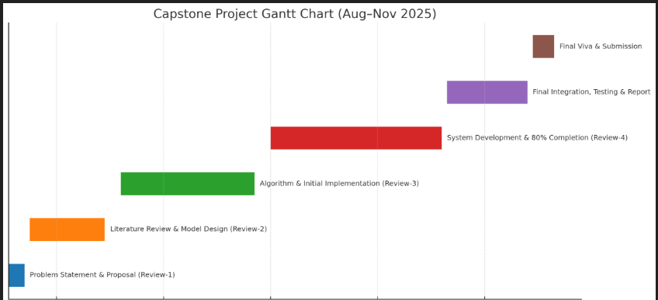
Timeline of the Project (Gantt Chart)

Slide 14
References (IEEE Paper format)
Autonomous Aerial Delivery Vehicles: A Survey (arXiv, 2023)
Design and Control of an Ultra-Low-Cost Logistic Delivery UAV (MDPI, 2022)
Autonomous Drone Delivery to Your Door and Yard (arXiv, 2022)
Embedded Payload Solutions in UAVs (MDPI, 2022)
Autonomous Delivery of Multiple Packages Using Single Drone (arXiv, 2022)

Slide 15


